Slide 1
Chapter 3 Process Description and Control
Operating Systems: Internals and Design Principles
Ninth Edition
By William Stallings
Notes:
“Operating Systems: Internal and Design Principles”, 9/e, by William Stallings, Chapter 3 “Process Description and Control”.

Slide 2
Process Scheduling
The following scheduling is for multiprocessing systems
Scheduling can be divided into three (3) phases
Long term
Medium term
Short term

Slide 3
Process Scheduling
Long Term Scheduling (a.k.a Job Scheduling)
Determines which jobs may compete for systems resources.
Its main objective is to provide the medium term scheduler with an appropriate number of jobs. WHY ?
Too few → The CPU may seat idle because all jobs are blocked
Too many → The Memory Management System becomes overloaded → system performance will take a hit → it will degradate

Slide 4
Process Scheduling
Medium Term Scheduling (a.k.a Swapper)
Its function is to swap processes in and out of memory
In multiprocessing systems it supports the Memory management system in the task of fitting jobs that are actually needed in a limited resource (memory)

Slide 5
Process Scheduling
Short Term Scheduling (a.k.a Dispatcher)
It is the one that will allocate the Processor (CPU) to a process that is already loaded into main memory and ready to run.

Slide 6
Scheduling Algorithms
Today’s systems → Preemptive
It means that the scheduler may preempt a process before it blocks or terminates, in order to allocate the CPU to another process.
Preemptive scenarios are a necessity in today’s systems. The main idea is to avoid monopolization of the CPU, and give processes in the ready queue and opportunity to get something done.
Imagine and interactive system (user – computer)
Notes:
.

Slide 7
Scheduling Algorithms
We will examine Six (6)
First Come First Served (FCFS)
Shortest Job First (SJF)
Shortest Remaining Time (SRT)
Round Robin (RR)
Priority
Multilevel Feedback Queues

Slide 8
Scheduling Algorithms
First Come First Served (FCFS)
Jobs are scheduled in the order that they are received.
It is nonpreemtive

Slide 9
Scheduling Algorithms
Shortest Job First (SJF)
Nonpreemptive.
The job with the shortest processing time will be the one that will be selected.
So what happens if two processes have the same processing time? Answer: First Come First Served can be used.

Slide 10
Scheduling Algorithms
Shortest Remaining Time (SRT)
It is a preemptive version of the shortest job first.
Any time a new process enters the pool of processes to be scheduled, the scheduler compares the expected value for its remaining processing time with that of the process currently scheduled. If the new process’s time is less, the currently scheduled process is preempted.
Like SJF, SRT favors shorts jobs, long jobs can be victims of starvation

Slide 11
Scheduling Algorithms
Round Robin
It is a preemptive algorithm
It will select the process that has been waiting the longest.
How does it work?: after a specified time quantum, the running process is preempted and a new selection is made. Interrupts from an interval timer ensure that processing is suspended and control is transferred to the scheduling algorithm at the conclusion of the time quantum.
Extensively used in time shared systems
context switches

Slide 12
Scheduling Algorithms
Priority
Each process must be assigned a priority value
The selected process will be the one with the highest priority
What will be done in case of a tie between two or more processes? → First Come First Served will be used
Priority mechanisms: There are many
Process related Memory usage, I/O frequency
User related: user or administrator
An others

Slide 13
Scheduling Algorithms
Multilevel Feedback Queues (MFQ)
All the previous algorithms basically treat all the jobs the same. This means that the previous algorithms some how favor some process over others. This algorithm is designed to address such deficiency
This algorithm customizes the scheduling for a process based on the process’s performance characteristics

Slide 14
Suspended Processes
Swapping
Involves moving part of all of a process from main memory to disk
When none of the processes in main memory is in the Ready state, the OS swaps one of the blocked processes out on to disk into a suspend queue
This is a queue of existing processes that have been temporarily kicked out of main memory, or suspended
The OS then brings in another process from the suspend queue or it honors a new-process request
Execution then continues with the newly arrived process
Swapping, however, is an I/O operation and therefore there is the potential for making the problem worse, not better. Because disk I/O is generally the fastest I/O on a system, swapping will usually enhance performance
Notes:
Recall that the reason for all of this elaborate machinery is that I/O activities
are much slower than computation and therefore the processor in a uniprogramming
system is idle most of the time. But the arrangement of Figure 3.8b does not entirely
solve the problem. It is true that, in this case, memory holds multiple processes and
that the processor can move to another process when one process is blocked. But the
processor is so much faster than I/O that it will be common for all of the processes in
memory to be waiting for I/O. Thus, even with multiprogramming, a processor could
be idle most of the time.
What to do? Main memory could be expanded to accommodate more processes.
But there are two flaws in this approach. First, there is a cost associated with
main memory, which, though small on a per-byte basis, begins to add up as we get
into the gigabytes of storage. Second, the appetite of programs for memory has
grown as fast as the cost of memory has dropped. So larger memory results in larger
processes, not more processes.
Another solution is swapping, which involves moving part or all of a process
from main memory to disk. When none of the processes in main memory is in the
Ready state, the OS swaps one of the blocked processes out on to disk into a suspend
queue. This is a queue of existing processes that have been temporarily kicked
out of main memory, or suspended. The OS then brings in another process from the
suspend queue, or it honors a new-process request. Execution then continues with
the newly arrived process.
Swapping, however, is an I/O operation, and therefore there is the potential
for making the problem worse, not better. But because disk I/O is generally the
fastest I/O on a system (e.g., compared to tape or printer I/O), swapping will usually
enhance performance.

Slide 15
Notes:
With the use of swapping as just described, one other state must be added to
our process behavior model ( Figure 3.9a ): the Suspend state. When all of the processes
in main memory are in the Blocked state, the OS can suspend one process by
putting it in the Suspend state and transferring it to disk. The space that is freed in
main memory can then be used to bring in another process.
When the OS has performed a swapping-out operation, it has two choices for
selecting a process to bring into main memory: It can admit a newly created process
or it can bring in a previously suspended process. It would appear that the preference
should be to bring in a previously suspended process, to provide it with service
rather than increasing the total load on the system.
But this line of reasoning presents a difficulty. All of the processes that have
been suspended were in the Blocked state at the time of suspension. It clearly would
not do any good to bring a blocked process back into main memory, because it is
still not ready for execution. Recognize, however, that each process in the Suspend
state was originally blocked on a particular event. When that event occurs, the process
is not blocked and is potentially available for execution.
Therefore, we need to rethink this aspect of the design. There are two independent
concepts here: whether a process is waiting on an event (blocked or not) and
whether a process has been swapped out of main memory (suspended or not). To
accommodate this 2 X 2 combination, we need four states:
• Ready: The process is in main memory and available for execution
• Blocked: The process is in main memory and awaiting an event.
• Blocked/Suspend: The process is in secondary memory and awaiting an event.
• Ready/Suspend: The process is in secondary memory but is available for execution
as soon as it is loaded into main memory.
Before looking at a state transition diagram that encompasses the two new suspend
states, one other point should be mentioned. The discussion so far has assumed
that virtual memory is not in use and that a process is either all in main memory
or all out of main memory. With a virtual memory scheme, it is possible to execute
a process that is only partially in main memory. If reference is made to a process
address that is not in main memory, then the appropriate portion of the process can
be brought in. The use of virtual memory would appear to eliminate the need for
explicit swapping, because any desired address in any desired process can be moved
in or out of main memory by the memory management hardware of the processor.
However, as we shall see in Chapter 8, the performance of a virtual memory system
can collapse if there is a sufficiently large number of active processes, all of which
are partially in main memory. Therefore, even in a virtual memory system, the OS
will need to swap out processes explicitly and completely from time to time in the
interests of performance.

Slide 16
Notes:
Let us look now, in Figure 3.9b , at the state transition model that we have
developed. (The dashed lines in the figure indicate possible but not necessary transitions.)
Important new transitions are the following:
• Blocked : Blocked/Suspend: If there are no ready processes, then at least
one blocked process is swapped out to make room for another process that
is not blocked. This transition can be made even if there are ready processes
available, if the OS determines that the currently running process or a ready
process that it would like to dispatch requires more main memory to maintain
adequate performance.
• Blocked/Suspend : Ready/Suspend: A process in the Blocked/Suspend state
is moved to the Ready/Suspend state when the event for which it has been
waiting occurs. Note that this requires that the state information concerning
suspended processes must be accessible to the OS.
• Ready/Suspend : Ready: When there are no ready processes in main memory,
the OS will need to bring one in to continue execution. In addition, it
might be the case that a process in the Ready/Suspend state has higher priority
than any of the processes in the Ready state. In that case, the OS designer may
dictate that it is more important to get at the higher-priority process than to
minimize swapping.
• Ready : Ready/Suspend: Normally, the OS would prefer to suspend a
blocked process rather than a ready one, because the ready process can now
be executed, whereas the blocked process is taking up main memory space
and cannot be executed. However, it may be necessary to suspend a ready
process if that is the only way to free up a sufficiently large block of main
memory. Also, the OS may choose to suspend a lower–priority ready process
rather than a higher–priority blocked process if it believes that the blocked
process will be ready soon.
Several other transitions that are worth considering are the following:
• New - Ready/Suspend and New - Ready: When a new process is created, it
can either be added to the Ready queue or the Ready/Suspend queue. In either
case, the OS must create a process control block and allocate an address space
to the process. It might be preferable for the OS to perform these housekeeping
duties at an early time, so that it can maintain a large pool of processes that are
not blocked. With this strategy, there would often be insufficient room in main
memory for a new process; hence the use of the (New S- Ready/Suspend)
transition. On the other hand, we could argue that a just-in-time philosophy of
creating processes as late as possible reduces OS overhead and allows that OS
to perform the process creation duties at a time when the system is clogged with
blocked processes anyway.
• Blocked/Suspend - Blocked: Inclusion of this transition may seem to be poor
design. After all, if a process is not ready to execute and is not already in main
memory, what is the point of bringing it in? But consider the following scenario:
A process terminates, freeing up some main memory. There is a process in the
(Blocked/Suspend) queue with a higher priority than any of the processes in
the (Ready/Suspend) queue and the OS has reason to believe that the blocking
event for that process will occur soon. Under these circumstances, it would
seem reasonable to bring a blocked process into main memory in preference
to a ready process.
• Running - Ready/Suspend: Normally, a running process is moved to the
Ready state when its time allocation expires. If, however, the OS is preempting
the process because a higher-priority process on the Blocked/Suspend queue
has just become unblocked, the OS could move the running process directly to
the (Ready/Suspend) queue and free some main memory.
• Any State - Exit: Typically, a process terminates while it is running, either
because it has completed or because of some fatal fault condition. However, in
some operating systems, a process may be terminated by the process that created
it or when the parent process is itself terminated. If this is allowed, then a
process in any state can be moved to the Exit state.

Slide 17
Characteristics of a Suspended Process
The process is not immediately available for execution
The process may or may not be waiting on an event
The process was placed in a suspended state by an agent: either itself, a parent process, or the OS, for the purpose of preventing its execution
The process may not be removed from this state until the agent explicitly orders the removal
Notes:
We can generalize the concept of a suspended process. Let us define a
suspended process as having the following characteristics:
1. The process is not immediately available for execution.
2. The process may or may not be waiting on an event. If it is, this blocked condition
is independent of the suspend condition, and occurrence of the blocking
event does not enable the process to be executed immediately.
The process was placed in a suspended state by an agent: either itself, a parent
process, or the OS, for the purpose of preventing its execution.
4. The process may not be removed from this state until the agent explicitly
orders the removal.

Slide 18
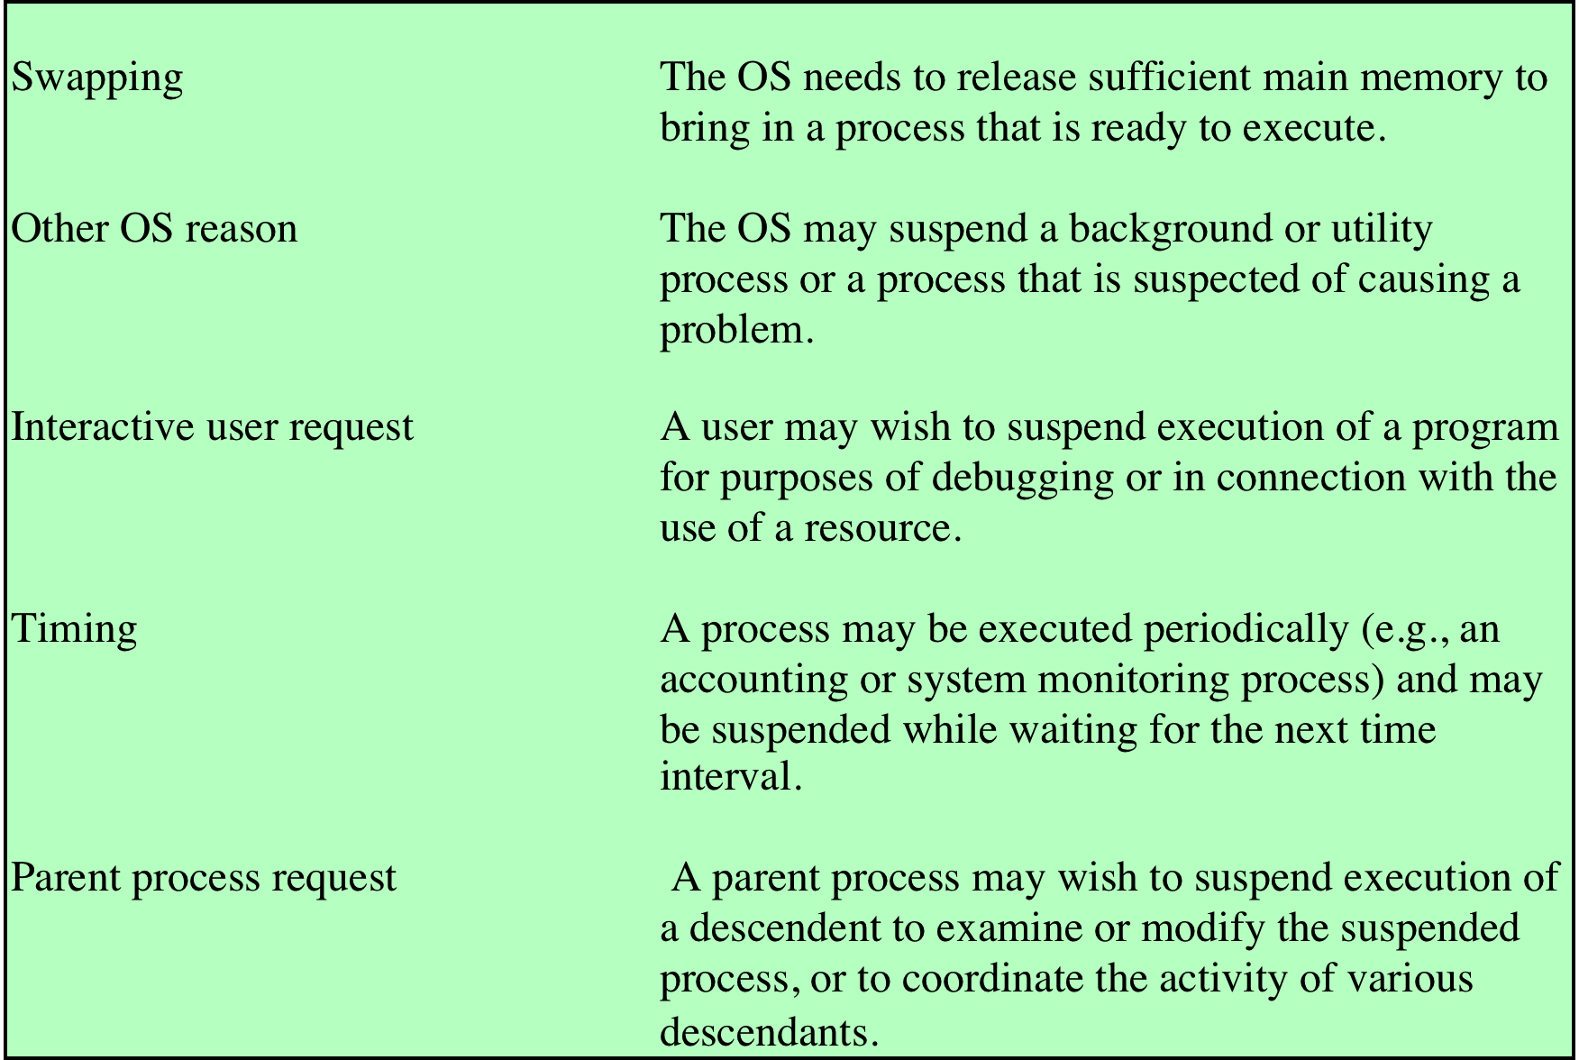
Table 3.3 Reasons for Process Suspension
Notes:
Table 3.3 lists some reasons for the suspension of a process. One reason that
we have discussed is to provide memory space either to bring in a Ready/Suspended
process or to increase the memory allocated to other Ready processes. The OS may
have other motivations for suspending a process. For example, an auditing or tracing
process may be employed to monitor activity on the system; the process may
be used to record the level of utilization of various resources (processor, memory,
channels) and the rate of progress of the user processes in the system. The OS,
under operator control, may turn this process on and off from time to time. If the
OS detects or suspects a problem, it may suspend a process. One example of this
is deadlock, which is discussed in Chapter 6 . As another example, a problem is
detected on a communications line, and the operator has the OS suspend the process
that is using the line while some tests are run.
Another set of reasons concerns the actions of an interactive user. For example, if
a user suspects a bug in the program, he or she may debug the program by suspending
its execution, examining and modifying the program or data, and resuming execution.
Or there may be a background process that is collecting trace or accounting statistics,
which the user may wish to be able to turn on and off.
Timing considerations may also lead to a swapping decision. For example, if a
process is to be activated periodically but is idle most of the time, then it should be
swapped out between uses. A program that monitors utilization or user activity is
an example.
Finally, a parent process may wish to suspend a descendent process. For example,
process A may spawn process B to perform a file read. Subsequently, process B
encounters an error in the file read procedure and reports this to process A. Process
A suspends process B to investigate the cause.
In all of these cases, the activation of a suspended process is requested by the
agent that initially requested the suspension.

Slide 19
The OS Managing Different Scenarios
Notes:
The OS controls events within the computer system. It schedules and dispatches
processes for execution by the processor, allocates resources to processes, and
responds to requests by user processes for basic services. Fundamentally, we can
think of the OS as that entity that manages the use of system resources by processes.
This concept is illustrated in Figure 3.10 . In a multiprogramming environment,
there are a number of processes (P ₁ ,…, P _{n} ) that have been created and exist in
virtual memory. Each process, during the course of its execution, needs access to
certain system resources, including the processor, I/O devices, and main memory. In
the figure, process P ₁ is running; at least part of the process is in main memory, and
it has control of two I/O devices. Process P ₂ is also in main memory but is blocked
waiting for an I/O device allocated to P ₁ . Process P _{n} has been swapped out and is
therefore suspended.

